Slide 1

Stephanie’s Creations: Sprint 5 Review
Team 5:
Hannah Clark | Heather Siler | Lauren Geis
Notes:
Presenter: Lauren
Transition to next Presenter: NA this slide

Slide 2
Sprint 5 Introduction
Migration Plan
Sprint Highlights
Business Readiness
Technical Readiness
People Readiness
Sprint Backlog
Sprint Burndown
Sprint PSPI
Notes:
Presenter: Heather
Transition to next Presenter: NA this slide

Slide 3
Migration plan
Notes:
Presenter: Heather
Transition to next Presenter: NA this slide

Slide 4
Business Readiness
-Go-Live Verification
-Parallel Run Monitoring
-Business Process Monitoring
-Stakeholder Communication
Technical Readiness
-System Performance Monitoring
-Infrastructure Stability Checks
-Security Monitoring
-Log Analysis
People Readiness
-Go-Live Support
-User Feedback
-Refresher Training
-Knowledge Transfer
Notes:
Presenter: Heather
Transition to next Presenter: NA this slide

Slide 5
Business Readiness
Activity | Focus | Action | Success
Go-Live Verification | Verify core functions | Execute documented test cases (Business Analysts, Key Users) | Completion of all critical test cases
Parallel Run Monitoring | Compare order volume, processing time, error rates between old/new systems | Daily monitoring of defined metrics (Business Analysts) | New system performance meets/exceeds old system
Business Process Monitoring | Identify inefficiencies in new system | Weekly review of process flows (Business Analysts) | Continuous improvement in process efficiency based on monitoring
Stakeholder Communication | Communication of system status and issues | Daily status emails, progress meetings (Project Manager) | Issues communicated within 24 hours and resolution suggested/implemented within 24 hours.
Notes:
Presenter: Heather
Transition to next Presenter: NA this slide

Slide 6
Technical Readiness
Activity | Focus | Action | Success
System Performance Monitoring | Ensure system stability/performance against KPIs | Continuous monitoring using Prometheus/Grafana (System Admin, DevOps) | System performance within defined thresholds (Response Time <3 secs, CPU <70%)
Infrastructure Stability Checks | Verify health of servers, network, and databases | Execute automated health checks and manual reviews (System Admin) | No critical infrastructure failures
Security Monitoring | Detect and respond to security threats | Continue monitoring using SIEM (System Admin, Security Team) | No successful security breaches
Log Analysis | Identify potential issues through log review | Analyze system, application and security logs. (System Admin, Technical Leads) | Proactive identification and resolution of issues – within 24 hours
Notes:
Presenter: Heather
Transition to next Presenter: NA this slide
Transition to next Presenter: NA this slide

Slide 7
People Readiness
Activity | Focus | Action | Success
Go-Live Support | Provide timely support to users | Manage support requests with SLA targets (System Admin, Technical Team) | Requests resolved within 24 hours
User Feedback Collection | Gather user experience feedback | Post-go-live surveys (Project Manager, Business Analyst) | User satisfaction remains > 80% positive feedback
Refresher Training | Provide additional training based on support request and feedback surveys | Schedule and deliver targets training sessions (Project Manager, Business Analyst) | Reduction in number of support tickets
Knowledge Transfer | Ensure internal teams have sufficient knowledge to support the system | Regular documentation reviews and knowledge-sharing sessions (Project Manager, Business Analyst, System Admin) | Reduction in regular support provided by the project team to maintain typical system maintenance
Notes:
Presenter: Heather
Transition to next Presenter: NA this slide

Slide 8




Implementation Timeline
Go-Live
Monitoring
Feedback & Re-Training
Migration Complete
May 31, 2025
June 4, 2025
June 14, 2025
July 29, 2025
Notes:
Presenter: Lauren
Transition to next Presenter: NA this slide

Slide 9
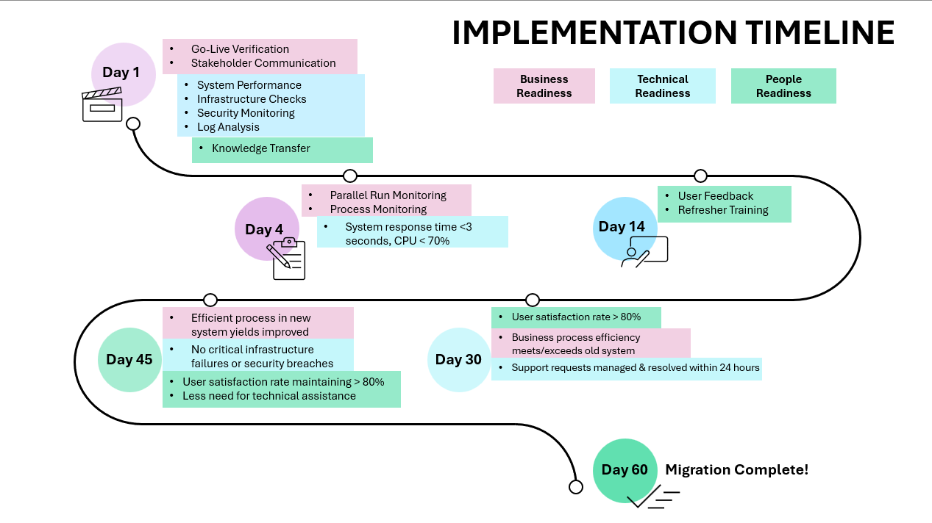
Notes:
Presenter: Lauren
Transition to next Presenter: NA this slide

Slide 10
Sprint highlights
Notes:
Presenter: Hannah
Transition to next Presenter: NA this slide

Slide 11
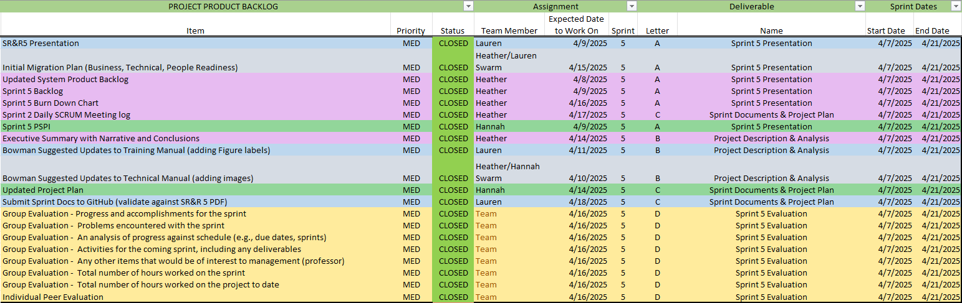
Notes:
Presenter: Hannah
Transition to next Presenter: NA this slide

Slide 12
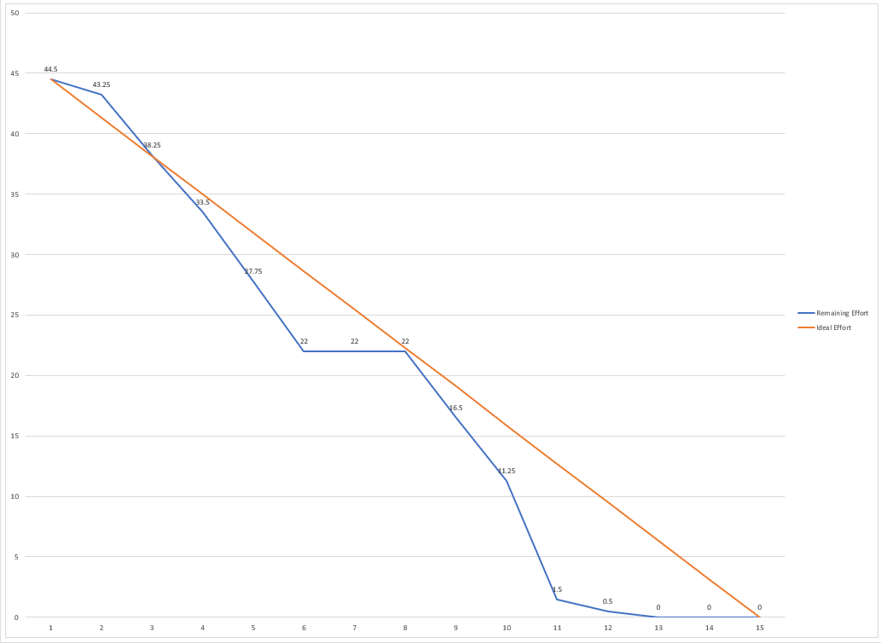
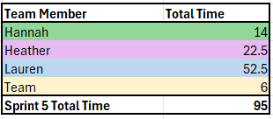
Notes:
Presenter: Hannah
Transition to next Presenter: NA this slide

Slide 13
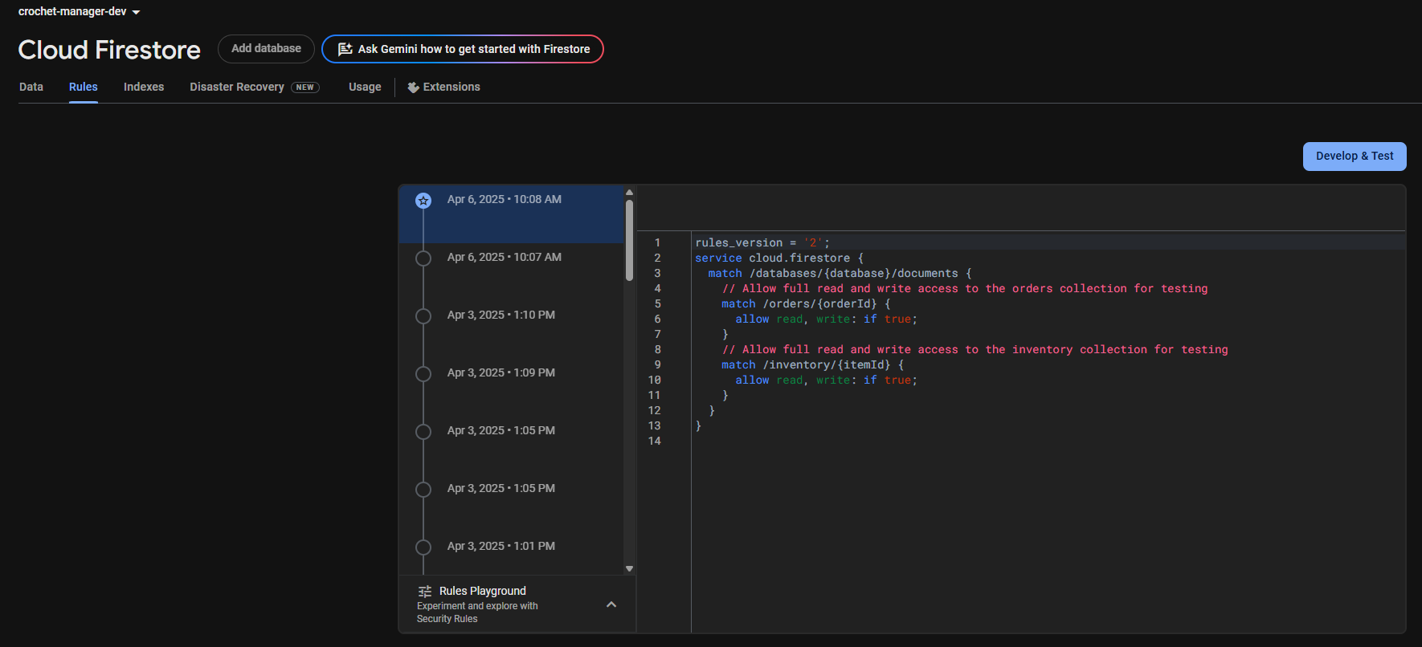
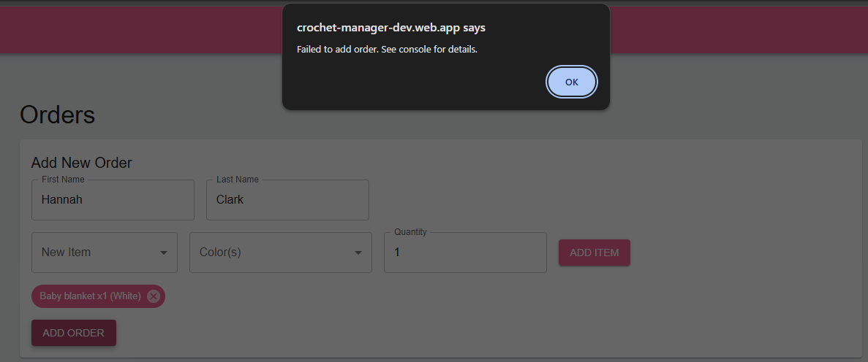
Notes:
Presenter: Hannah
Transition to next Presenter: NA this slide

Slide 14

Any Questions?
Notes:
Presenter: Heather
Transition to next Presenter: NA this slide
we would like to encourage your feedback on the deliverables we demo’d.
Your input is crucial for ensuring that we are on the right track.
Please feel free to ask any questions or share any feedback you have now.

